Slide 1
MCA Final Year Project (Review I) AI-Powered Virtual Health Assistant
Submitted to the Presidency University, Bengaluru in partial fulfillment for the award of the degree of Master of Computer Applications(MCA)
Project Number : 222
Under the supervision of
Mr. Sakthi S Asst. Prof, Department of SCSE School of Computer Science and Engineering
Name | Roll Number
Latha Kamath M K | 20232MCA0058

Slide 2
Content
Problem Statement
Literature Survey
Tools and Technologies to be used
Timeline of the Project
GitHub
References

Slide 3
Problem Statement
Healthcare Challenges: Overburdened systems, lack of expertise in remote areas, high costs, and privacy concerns.
Limitations of Traditional Services: Long waiting times, limited doctor availability, and poor medical record management.
AI-Powered Solution: NLP and ML for symptom analysis, AI consultations, and real-time doctor recommendations.
Blockchain for Security: Secure, tamper-proof medical record management ensuring data privacy.
Accessibility and Affordability: Web and mobile apps for convenient, efficient, and affordable healthcare.

Slide 4
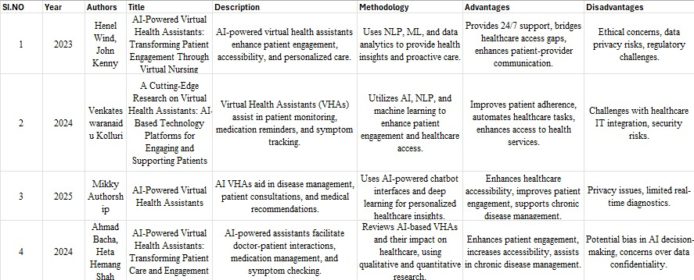
Literature Review

Slide 5
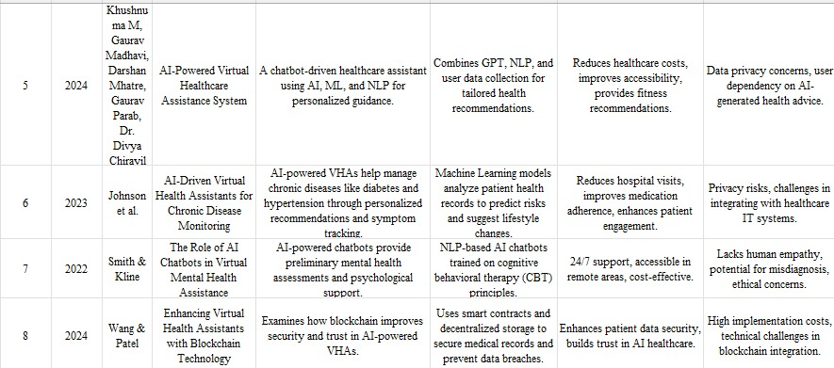

Slide 6
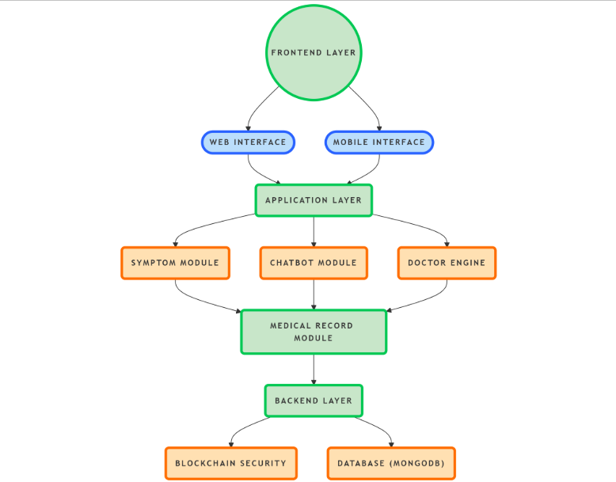
Module Design

Slide 7
Frontend Layer:
User interface for interaction through web and mobile platforms.
Web Interface:
Allows users to access HealSmart via browsers.
Mobile Interface:
Provides on-the-go access to HealSmart through mobile apps.
Application Layer:
Handles core functionalities like symptom analysis, chatbot, and doctor recommendans.
Symptom Module:
Analyzes user symptoms and provides potential health conditions.
6. Chatbot Module:
Engages users in real-time health-related conversations.

Slide 8
7. Doctor Engine:
Suggests doctors based on symptoms, location, and medical history.
8. Medical Record Module:
Manages and stores patient medical records securely.
9. Backend Layer:
Handles data processing, storage, and security operations.
10. Blockchain Security:
Ensures secure and tamper-proof storage of medical records.
11. Database (MongoDB):
Stores user profiles, symptom history, and doctor information.

Slide 9
Modular Breakdown
Module 1: Data Collection
Gathers user inputs via text, voice, or chatbot interactions.
Uses NLP libraries (spaCy, NLTK, Hugging Face) to process user queries.
Collects symptom-related data from users for further analysis.
Integrates with GPS services (Google Maps API) to fetch doctor location details.
Module 2: Data Processing
Analyzes symptoms using Machine Learning (TensorFlow, PyTorch, Scikit-Learn) to predict possible health conditions.
Utilizes Deep Learning models for better diagnosis accuracy.
Processes and secures medical data using Blockchain (Ethereum, Hyperledger Fabric) for tamper-proof storage.
Maintains patient records in a database (MongoDB, PostgreSQL) for future reference.
Module 3: Analysis & Output
The chatbot provides real-time health recommendations based on symptom analysis.
Suggests nearby doctors and hospitals using location-based services.
Uses Speech-to-Text (Google Cloud Speech, Whisper AI) for voice-enabled interactions.
Ensures secure authentication (JWT, OAuth 2.0, Firebase Authentication) to protect user data.

Slide 10
Tools And Technologies To Be Used
Front-End Development (User Interface):
Web Application: React.js – Interactive and responsive UI.
Mobile Application: Android (Kotlin/Flutter) – Mobile accessibility.
UI Frameworks: Material UI / Tailwind CSS – User-friendly design
2. Back-End Development (Server & API):
Server Framework: Flask (Python) – Handles API requests.
API Development: FastAPI / Flask-RESTful – For secure RESTful APIs.
Database: PostgreSQL / MongoDB – Stores user data, symptoms, and doctor records.

Slide 11
3. AI & NLP (Machine Learning):
ML Frameworks: TensorFlow / PyTorch / Scikit-Learn – AI model training.
NLP Libraries: spaCy / NLTK / Hugging Face – Chatbot and text processing.
Symptom Prediction Model: Deep Learning / Decision Trees / Neural Networks.
4. Blockchain for Medical Record SecurityBlockchain:
Framework: Ethereum / Hyperledger Fabric – Secure, decentralized records.
Smart Contracts: Solidity – Manages access control.
Distributed Storage: IPFS – Tamper-proof document storage.
5. Additional Tools:
GPS Services: Google Maps API – Doctor recommendations.
Speech-to-Text: Whisper AI / Google Cloud Speech – Voice-enabled chatbot.
Authentication & Security: JWT / OAuth 2.0 / Firebase Authentication.

Slide 12
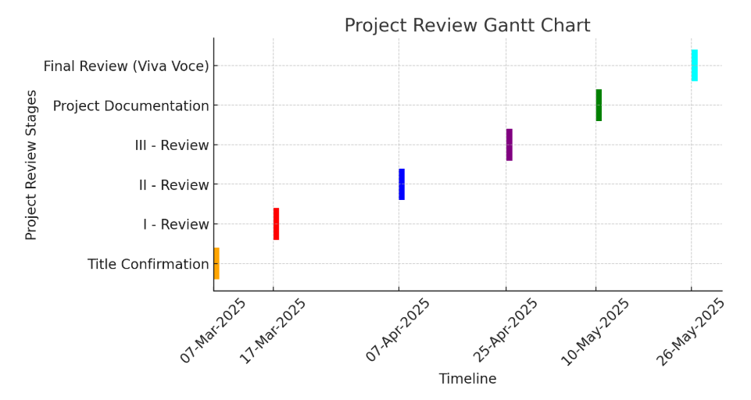
Timeline of the Project

Slide 13
GitHub Link
Lathakamathmk/AI-Powered-Virtual-Health-Assistant- · GitHub

Slide 14
References
1. H. Wind and J. Kenny, "AI-Powered Virtual Health Assistants: Transforming Patient Engagement Through Virtual Nursing," 2023.
Discusses AI-powered virtual health assistants' role in enhancing patient engagement and personalized care using NLP, ML, and data analytics.
2. V. Kolluri, "A Cutting-Edge Research on Virtual Health Assistants: AI-Based Technology Platforms for Engaging and Supporting Patients," 2024.
Explores how AI-driven VHAs assist in patient monitoring, medication reminders, and symptom tracking through AI, NLP, and machine learning.
3. M. Authorship, "AI-Powered Virtual Health Assistants," 2025.
Examines AI-driven VHAs in disease management, consultations, and medical recommendations with chatbot-based interactions and deep learning.
4. A. Bacha and H. H. Shah, "AI-Powered Virtual Health Assistants: Transforming Patient Care and Engagement," 2024.
Reviews AI-based VHAs for improving doctor-patient interactions and chronic disease management using qualitative and quantitative research.

Slide 15
K. M., G. Madhavi, D. Mhatre, G. Parab, and D. Chiravil, "AI-Powered Virtual Healthcare Assistance System," 2024.
A chatbot-driven AI-powered healthcare assistant integrating GPT, NLP, and ML for personalized health recommendations.
6. Johnson et al., "AI-Driven Virtual Health Assistants for Chronic Disease Monitoring," 2023.
Investigates AI-powered VHAs for managing chronic diseases such as diabetes and hypertension using ML-based patient record analysis.
7. Smith and Kline, "The Role of AI Chatbots in Virtual Mental Health Assistance," 2022.
Focuses on NLP-based AI chatbots trained on cognitive behavioral therapy (CBT) principles for mental health support.
8. Wang and Patel, "Enhancing Virtual Health Assistants with Blockchain Technology," 2024.
Examines the integration of blockchain technology for security and trust in AI-powered VHAs using smart contracts and decentralized storage.

Slide 16


